Slide 1
Jaromír
Jágr
the Czech Republic

Slide 2
Jaromír Jágr is the most productive European-born player who has ever played in the National Hockey League and is considered one of the greatest professional hockey players of all time. At age 43 he continues to play in the NHL, and is the oldest player to record a hat trick.
He is an Orthodox Christians

Slide 3
born February 15, 1972, Hnidousy village (a part of town Kladno nowadays)
Jágr began skating at the age of three, and he immediately showed exceptional abilities

Slide 4
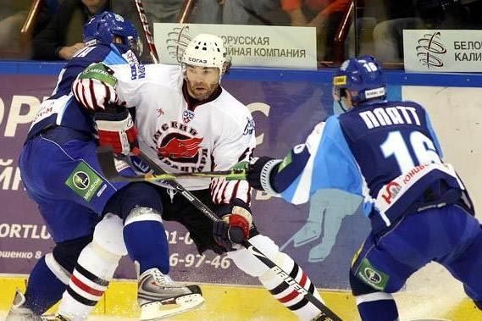
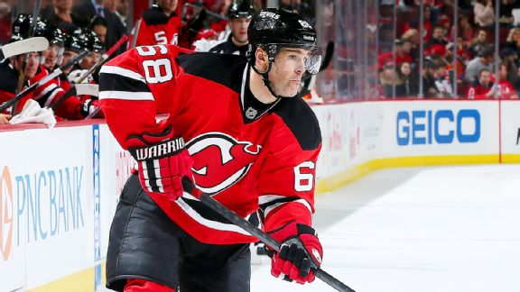
In the 1994–95 NHL season Jágr won his first Art Ross Trophy as the scoring champion of the NHL.
He is one of the best ice hockey players ever.

Slide 5
Jaromír likes pretty Czech girls, dogs and fun
Franta Růžička, 5.C

